Slide 1


MVC
By: Theodore Hancock

Slide 2
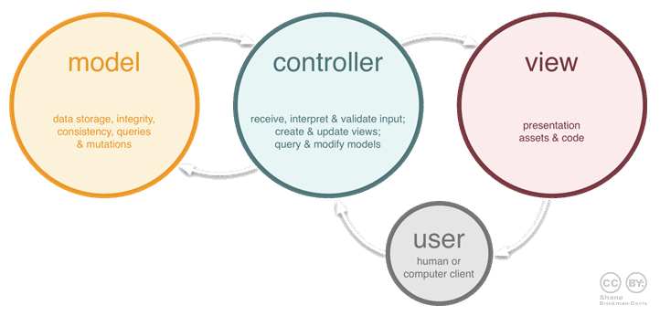
Model, View and Controller
Model - This part of the framework is to store the data of the application, such as databases, text data, files and/or other web resources.
View - This is the graphical user interface of the application. That would contain different buttons, text boxes and other controls to let the user interact with the application to complete his projects depending on the sort of the software he is using.
Controller - The actual back-end code constitutes the controller of the framework. A controller controls the data coming from the users, or going to the user from a model.

Slide 3
Example
Java file in eclipse

Slide 4
Works Cited
https://www.codeproject.com/Articles/879896/Programming-in-Java-using-the-MVC-Architecture

